Slide 1

ECE 3300 Project
Group E
Jordan Smith, Andy Ho, Jared Alanis, Benjamin Black

Slide 2
Abstract
This project aims to recreate the classic PONG game on the Nexys A7-100T FPGA using Verilog, introducing innovative features for enhanced gameplay. The implementation leverages a VGA display for rendering, with the game's point and lives displayed on an SSD. User interaction is facilitated through two buttons for vertical movement of the paddle and a reset button for initiating new games. A 4-bit switch customizes the number of lives before a game-over condition. In addition to the traditional PONG setup, the project incorporates a PWM module. Unlike the traditional use, this PWM functionality dynamically adjusts the intensity of an LED light, providing a visual cue that changes based on the selected difficulty level. Three individual switches enable users to choose between easy, medium, and hard difficulty levels. In addition to the LED serving as a visual indicator for difficulty, there are now three additional LEDs. These LEDs indicate when the ball has been hit, when the ball was missed, and when the game is over. This comprehensive approach combines hardware components, Verilog programming, and dynamic features like LED intensity adjustments and status LEDs to offer an engaging and adaptable PONG gaming experience on the FPGA platform.

Slide 3
Concept
Show the ability to manipulate different systems using a controller
Display feedback between the Nexys A7-100T FPGA Board and the monitor, reacting to the user's inputs

Slide 4
Basic Setup
For this particular Pong game, we have one side as a full wall, and the other side as the Player's paddle.
The ball bounces back and forth between the two, going faster depending on the difficulty.
A life will be lost upon the ball passing the player, and a game over will be reached upon losing all lives.
There is a point system based on the players performance.

Slide 5
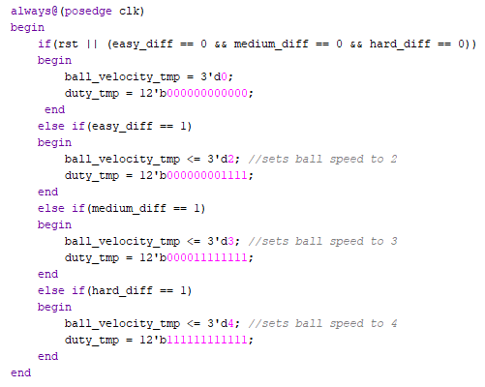
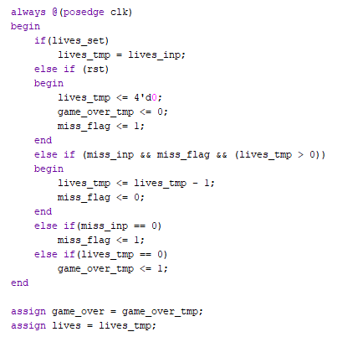
Adjustable Settings
Buttons:
Start Game, Reset, Up and Down Controls, Set Lives
Switches:
Set Difficulty (Easy, Medium, Hard)
Adjust Lives (0 – 15 Total)

Slide 6
Development Board Functions
Use buttons to adjust Pong paddle up or down.
SSDs change depending on number of lives held.
Leds light up according to game settings and current state of the game.
Led light up upon missing the ball, hitting the ball, or receiving a game over.
Additionally, RGB LEDs light up according to the difficulty selected.
Shifts from dim to bright light in relation to higher difficulty

Slide 7
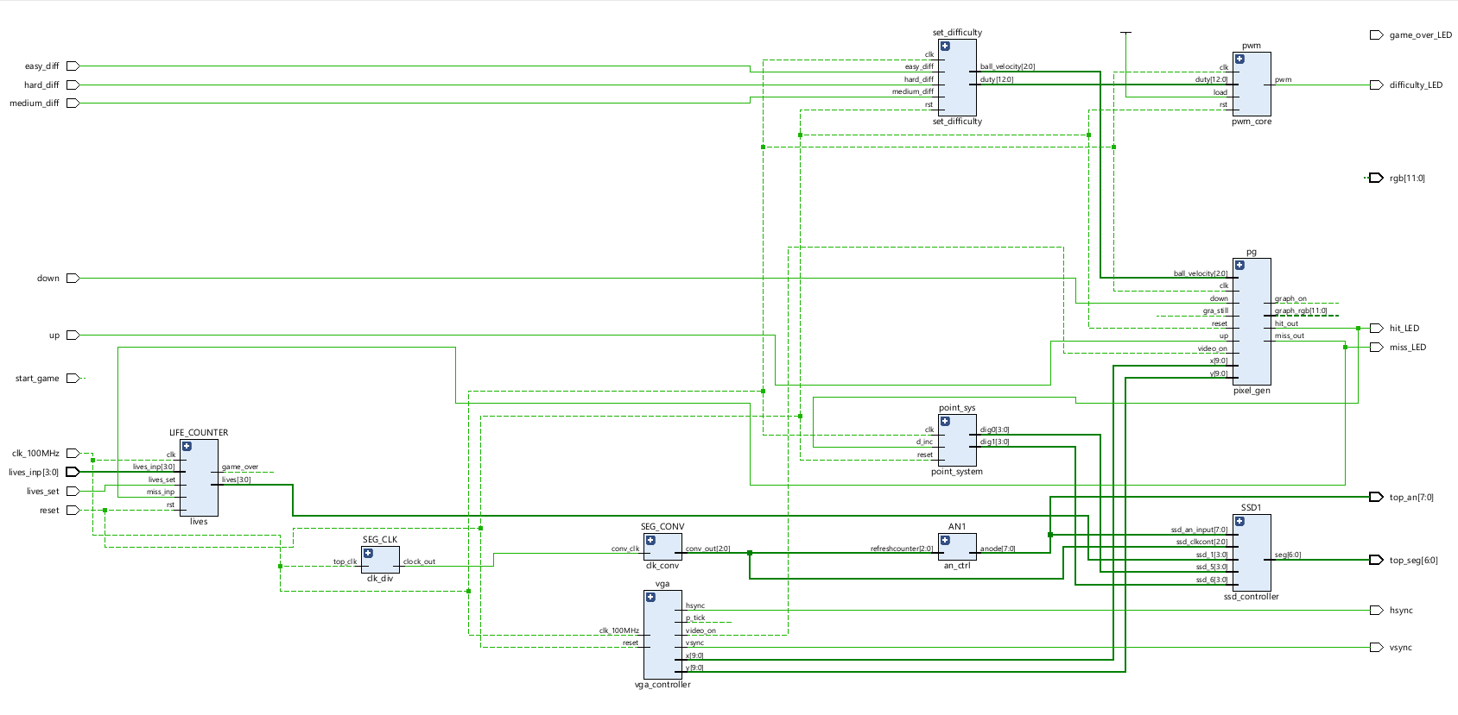
Game Schematic

Slide 8
Board Visuals

Slide 9
Demo

